Slide 1
Capstone Project I
Liz Francese

Slide 2
A note for the Coding Temple instructor
My coding journey began when my boss, the curriculum director for a small, rural public school district asked me the question:
Why does our data collection tool suck?
I won’t map out exactly how arrived here from there, however, I think my relationship to the data I am presenting is important.
I am not an educator and I do not have K-12 education experience in any professional capacity. Quite frankly, before starting this project I didn’t really understand these numbers at all.
In my role as the curriculum director’s assistant, however, I am regularly given lengthy documents full of complex ideas and asked to turn them into guides, manuals and graphics for educators to use. This presentation will feature some of those graphics and they’ll be clearly labeled as such. All other data, numbers and visualizations, however, were developed for this project.
Furthermore, as my own boss is knowledgeable about what this data means, the hypothetical audience for this project will be her bosses- the members of the school board.
Thank you,
Liz Francese
P.S. For confidentiality reasons, all student names have been redacted and the school names shown are aliases.

Slide 3
AimsWeb Data
Understanding WCSU’s Primary Benchmark Assessment Tool

Slide 4
Introduction
As a public school district, we rely on assessment data so that teachers can provide the most effective differentiated instruction with the least amount of disturbance.
AIMsWeb is our largest and most widely used benchmark assessment. It is taken by all students in grades K-8 in the fall, winter and spring.
Goals for analyzing AimsWeb data:
Visualize math and literacy scores across grade levels, schools and classrooms
Get a clear indication of student skill tiers at a glance
Find trends to aid in lesson planning, professional development and intervention
Protect student identities so as to reduce stigma
Analyze data as a subset of all assessments and progress monitoring tools*
*This goal will be met at a later date (maybe in Capstone II)

Slide 5
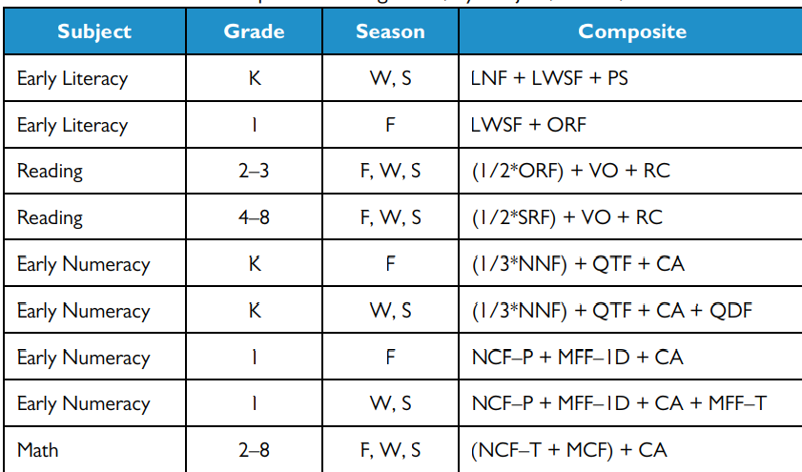
Battery Score
The first line shows that a Kindergartener’s overall Early Literacy score (only calculated in 2 & 3 trimesters of the school year), is determined by adding together scores from the Letter Naming Fluency, Letter Word Sounds Fluency and Phoneme Segmentation test sections.
Assessments differ from other types of testing in the use of norms or standardization. Unlike scoring a quiz out of 100 or grading on a curve, an assessment conduct a standardization study hat controls for various demographics to determine how students are scored.
When analyzing this data, we’ll start by looking at the battery or composite scores which use research based formulas to combine scores from various skills tested. The resulting score is a measure of skill in math and literacy more broadly.
The AIMSWeb formula for composite scores can be seen to the right. Fortunately, these scores are already included in the data set extracted from their database.
AIMsWebPlus Technical Manual

Slide 6
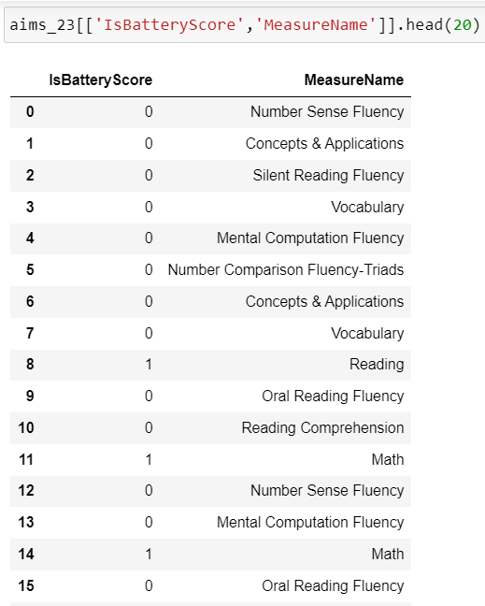
Battery Scores in Dataset
Sample shows first 20 of 15,053 rows
Right: Sample from AimsWeb
The column labeled ‘IsBatteryScore’ indicates if the row will results from individual tests or the student’s composite scores.
0 = skill test score 1 = composite score
Rows 8, 11 and 14 in this sample are composite or battery scores.

Slide 7
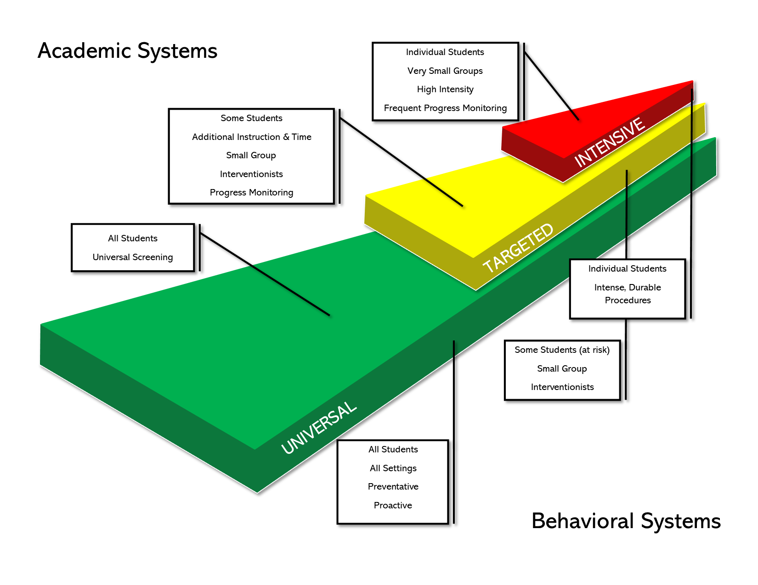
Multi-tiered Systems of Support
The final piece needed to understand the AimsWeb scoring system is the concept of multi-tiered systems of support.
As the diagram to right demonstrates, MTSS looks at various components of the student’s assessment results and breaks those results/skills into three tiers, which determine the level of intervention needed in the child’s learning or emotional support system.
Students are not classified by their tier name or color. Tiers simply refer to a point in time assessment of a necessary component of a student’s academic performance or, as seen to the right, their social and emotional health.
When looking at the data, Tier 1, Tier 2 and Tier 3 will also be referred to as Low, Moderate and High Risk.
MTSS graphic, WCSU LCAS, me

Slide 8
Data Structure

Slide 9
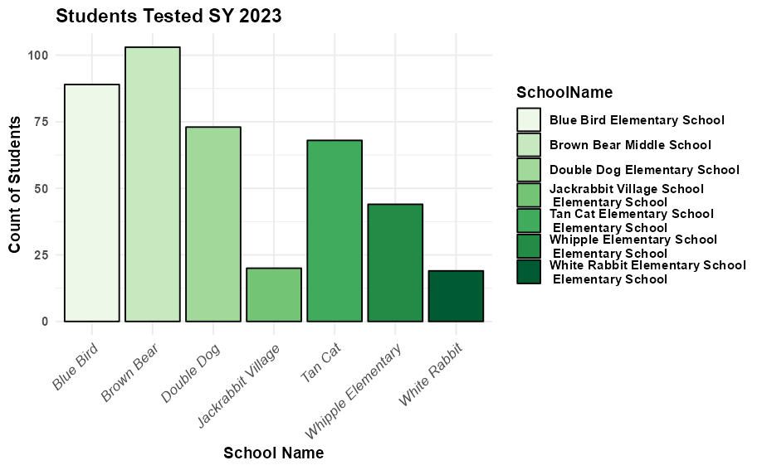
Data Demographics

Slide 10
Data Structure
Testing Season
(F,W,S)
In math, first grade seems to be doing the worst
Testing Category
(Math & Lit)
Student
414 in dataset
(id, grade, school, teacher)
Scores (battery and skill)
209/417 students are considered ‘high risk’
By grade level, the highest population of high risk students is in first grade
By school, its the middle school
Tier or
Risk Level

Slide 11
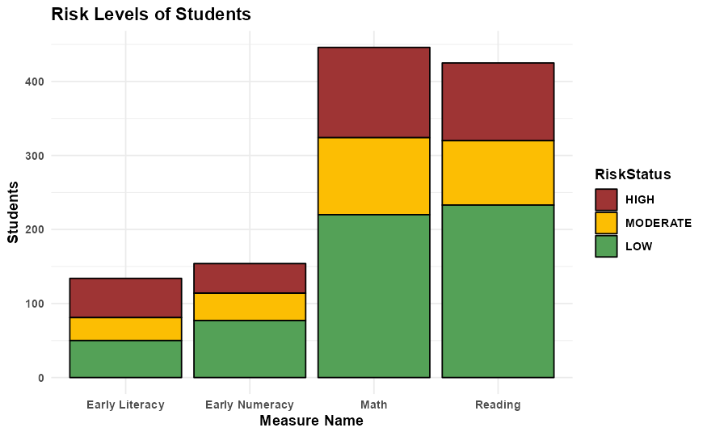
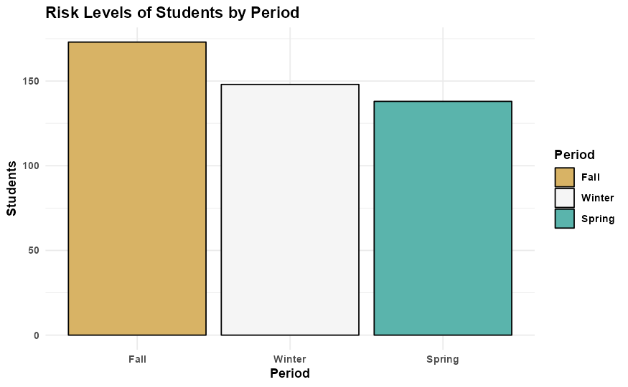
High Level View
Risk Levels, Testing Periods & Measures
In math, first grade seems to be doing the worst
The data in the first table shows how our students ‘risk levels’ or tiers came out on each type of assessment. The LOW portion should be at least half of the students.
To the right, we can see that the number of assessments in math and literacy at ‘high risk’ drops over time, which is the desired output.
209/417 students are considered ‘high risk’
By grade level, the highest population of high risk students is in first grade
By school, its the middle school
22-23 Student Battery Scores by “Risk Level”
Zooming in and looking at just high risk scores in the Spring, it’s clear that first grade literacy continues to needs investigating.

Slide 12
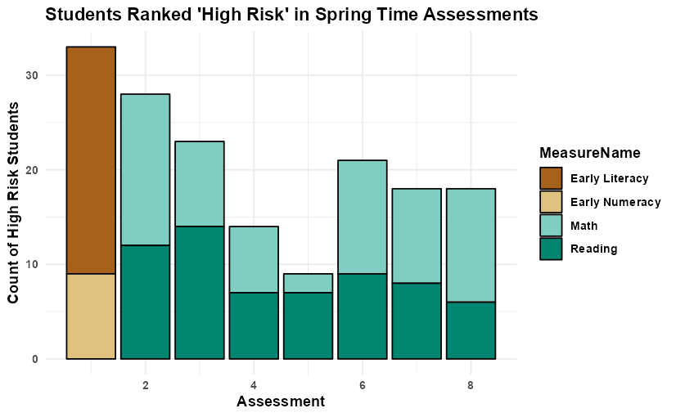
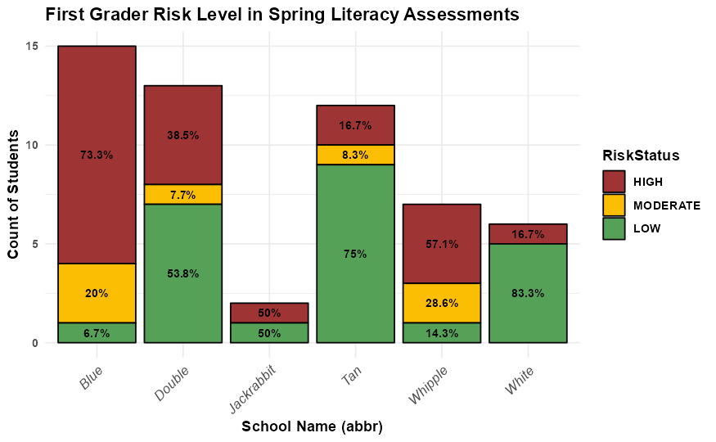
School Level View
In math, first grade seems to be doing the worst
Now we can clearly see that students at Jackrabbit, Whipple and Blue Bird Elementary Schools have at least 50% of their 1st grade students at high risk in literacy even at the end of the year.
209/417 students are considered ‘high risk’
By grade level, the highest population of high risk students is in first grade
By school, its the middle school

Slide 13
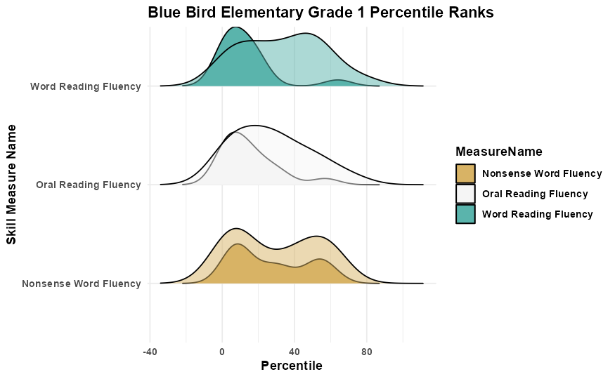
School Level View
The chart shows, that the majority of Blue Bird Elementary’s first grade classroom is below the 50th percentile in each skill set on both a national level (opaque) and on the district level (transparent).
In math, first grade seems to be doing the worst
This is significant because it shows that the core instruction is need of support. This is crucial for our analysis because it not only finds the broadest target for improvement but it pacifies the instinct to look at individual students first, which is not only a less accurate representation of the learning context, but all to frequently creates stigma. In case of standardized testing in particular, we should be more focused on the population at large than on individual students.
209/417 students are considered ‘high risk’
By grade level, the highest population of high risk students is in first grade
By school, its the middle school
50th Percentile
Student Target

Slide 14
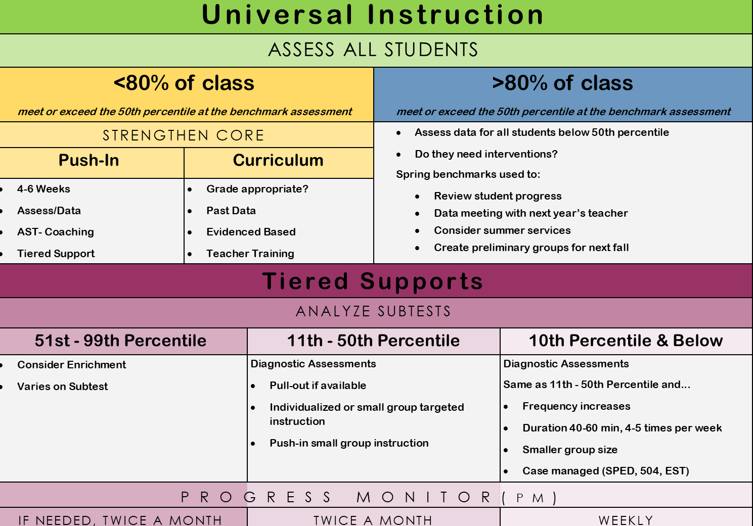
If less than 80% of the class score above the 50th percentile – as determined by AimsWeb standardized scores – whole classroom support should be practiced before small group or 1 to 1 student intervention.
Assessment and Support Procedure
Tiered Supports, WCSU LCAS, me

Slide 16
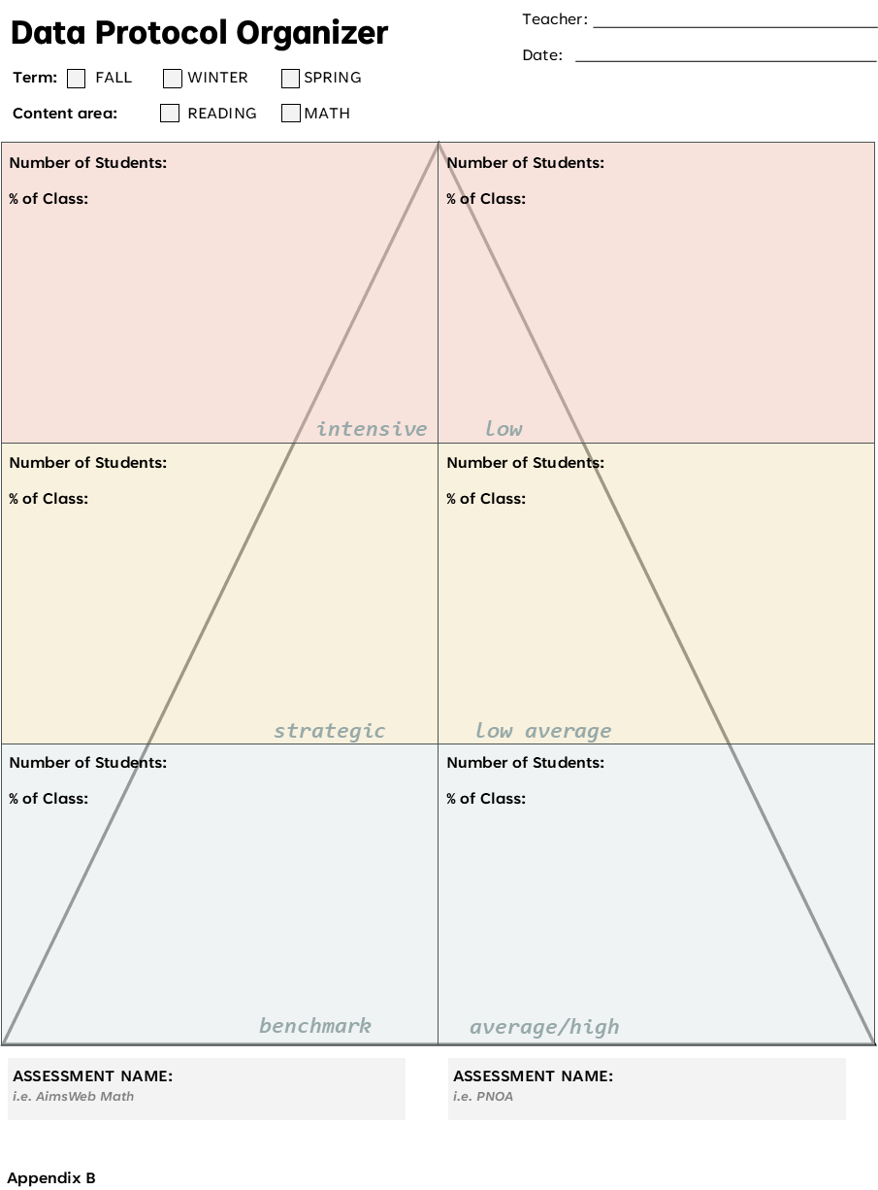
Data Protocol Organizer, WCSU Data Protocol, me
Assessment Chart

Slide 17
Put in links to LCAS, data protocol

